Slide 1
Data and Artificial Intelligence (AI) for B2B
August 2023 George Shevardenidze

Slide 2
Hey there! Thanks for checking out my presentation.
Just a heads-up, all the content you see here is my own work and I've put a lot of effort into it. Feel free to use any of the slides for educational or informational purposes; all I ask is that you give me proper credit by citing my name.
If you've got any questions or want to use this for something bigger, please reach out. Thanks!

Slide 3

George Shevardenidze
17 years experience in B2B professional services;
Domain expertise: commercial operations, business development, sales;
Key industries: oil & gas, energy, heavy machinery.
Coupled with:
Data science, Python, AI, Machine learning
Google and IBM data analyst certificate

Slide 4
Before we start…
Business centric
Data ‘science’ concepts will be reduced to a minimum
Engage in opportunity

Slide 5
We will talk about:
Data essentials
Data Analysis & AI
AI applications
AI integration
Open discussion
Presentation time: apprx. 25 mins

Slide 6
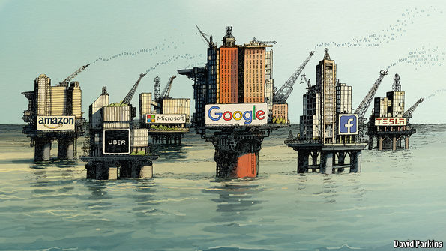
“Data is the New Oil”

Slide 7
So what ‘Data’ actually is?
Data is any information that can be collected and analyzed to gain insights and make informed decisions.
It can come in many forms, structured (like tables or files) or unstructured (text, images, audio and videos).
#More data has been generated in 2020-2023 than in all before history of human kind

Slide 8
“
Data is the new Oil. Data is just like crude. It’s valuable, but if unrefined it cannot really be used.”
— CLIVE HUMBY*
* British mathematician, entrepreneur in computer and data science

Slide 9
– Data science –
a discipline about understanding the data, making predictions,
and turning data into actionable insight

Slide 10
Data science approach
Manage the data
Tool Developers: Microsoft, Google, Amazon, IBM etc.
Data Experts: Data architects, governance, policy
Understand the data
Data Science: Statistics, computer science
Visualization Expertise: Interpret data, graph them in meaningful ways
Act on the data
Decision Making - Exec. & Management: Apply data to solve business issues
Industry Vertical Domain Expertise: Identify relevant business issues, ask the right questions
@deeplearning.ai

Slide 11
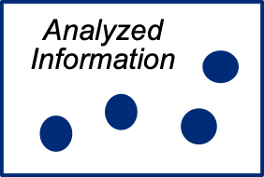
The Evolution of working with Data
Traditional Analytics
Descriptive Analytics: Summarizes past data to identify patterns
Diagnostic Analytics: Digs into data to understand the root causes
Business Intelligence: Uses data to create reports and dashboards for informed decisions
Structured & Repeatable
Question
Hypothesis
?
Answer
Data
Start with hypothesis
Test against selected data
@deeplearning.ai

Slide 12

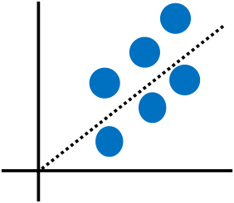
The Evolution of working with Data –> AI/ML
Big Data Analytics
Iterative & Exploratory
The shift from traditional data analysis to AI and ML is like moving from manual labor to automated machinery.
Machine speed and scale amplify human expertise and experience.
Predictive analytics: Data to make predictions.
Data
Exploration
Actionable Insight
Correlation
Data leads the way
Explore all data, identify correlations
@deeplearning.ai

Slide 13
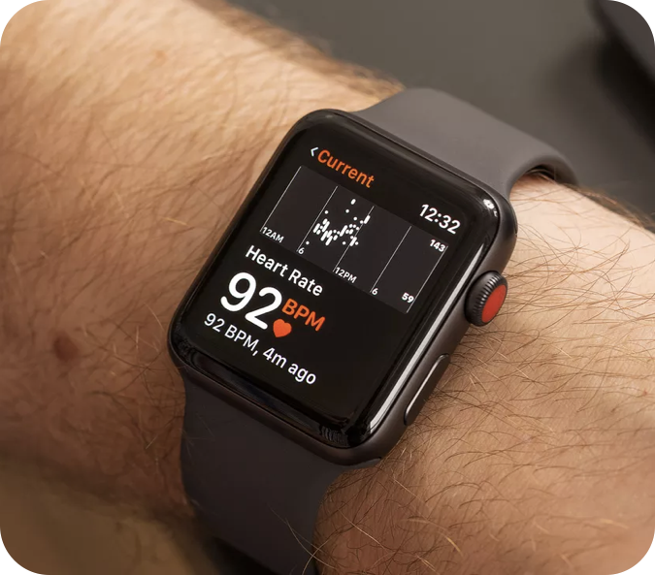
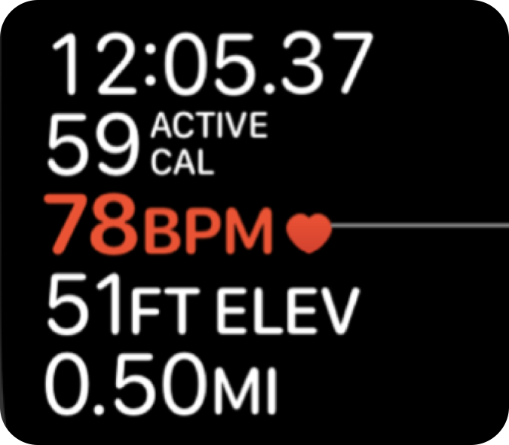
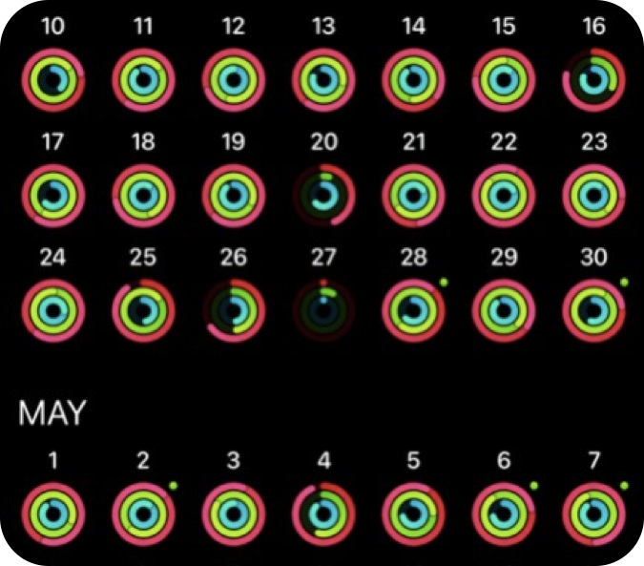
Example: Data in Healthcare
Big Data
Result
Data about heart rate, sleep quality, exercise and more
Improves tracking of health patterns
Gathered continuously and available in real time
Availability
@deeplearning.ai

Slide 14


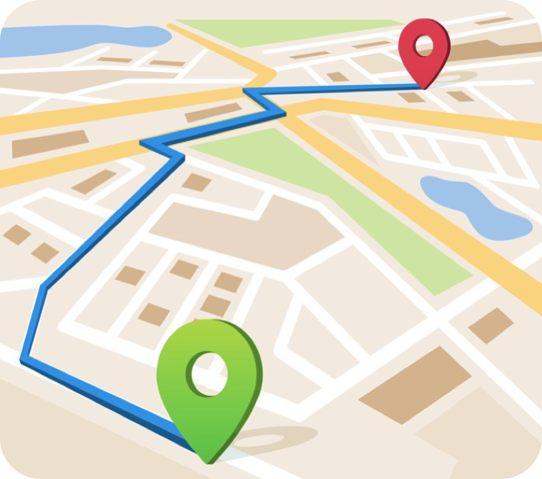
Example: Data in Transportation
Big Data
Result
Data about traffic, road closures, accidents, etc.
Allows for better route planning and scheduling
Available in a visual format in real time
Availability
@deeplearning.ai

Slide 15
Artificial Intelligence

Slide 16
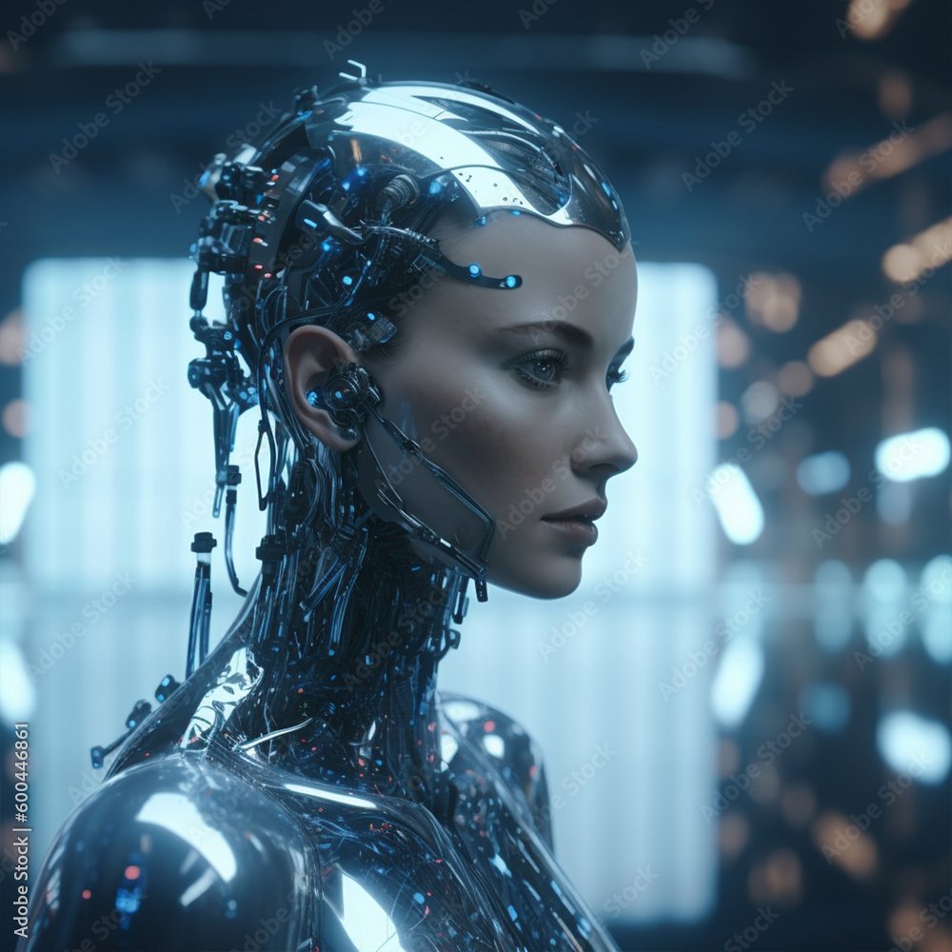
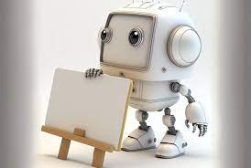
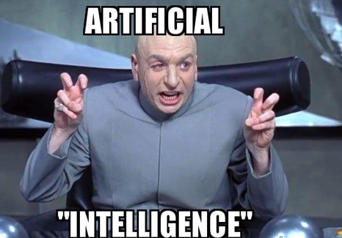
What is AI?

Slide 17
AI in simple words
Artificial intelligence (AI) is the field of computer science focused on creating systems, that think and act like humans
Understanding human language, decision making, self-learning and navigation in physical world are all tasks that can be done by AI.

Slide 18
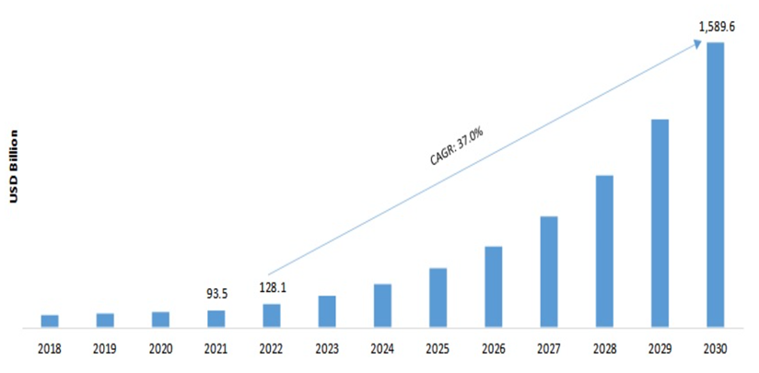
Rise of AI
Relatively new industry (2010’s onwards)
AI is seen to surpass influence of the Internet.
More Data than ever
Growth of computational powers.
*https://www.forbes.com/advisor/in/business/ai-statistics/

Slide 19
AI is about…
Predictions: AI uses historical data to forecast future outcomes, enhancing decision-making.
Automation: AI streamlines repetitive tasks, increasing efficiency and consistency.
Optimization: AI analyzes complex scenarios to find the best solutions, improving performance and reducing costs.

Slide 20
AI subfields
Machine Learning – machine learns from data
Computer Vision – machine recognizes and interprets objects
Robotics – machine interacts with object ins real world
Natural Language Processing – machine understands and generates human language

Slide 21
What is Machine Learning?
Machine learning (ML) is a subfield of AI
A set of methods that allow computers to learn from large volumes of data to find patterns, correlations & trends
ML is mostly used for making predictions and actionable insights
METHODS
APPLICATIONS OF ML
Regression: Predicts value.
Classification: Categorizes data.
Clustering: Groups similar data.
Decision Trees: Decision-making flowchart.
Neural Networks: Mimics brain processing.
Healthcare: Automated medical diagnosis
HR: Which applicants are best suited for a job
Tech: Voice interfaces, Autonomous cars, personalization
Finance: Investing
TIC: automated inspection, digital labs and more examples
@deeplearning.ai

Slide 22
Three Types of Machine Learning
Supervised
Learning
Unsupervised
Learning
Reinforcement
Learning
Develop predictive model based on input and output data
Group and interpret observations based only on input data
Acquire new data by taking actions and receiving ad hoc feedback
…is like learning to drive with an instructor
…is like exploring new routes in a city on your own
…is like learning to drive a race car. You adjust your driving based on lap times, learning from faster laps (rewards) and slower laps (penalties).
@deeplearning.ai

Slide 23
ML algorithms
ML algorithms are the tools we use to build our ML models.
Algorithms include regression, classification, clustering, multi-armed bandits, anomaly detection, decision trees, neural networks, deep neural networks etc.
The goal is to enable a user to find correlations, patterns, predict events, plan futher actions etc.

Slide 24
AI use cases examples:
Objective: Predict Customer Churn.
AI type: machine learning
Incl: Insights into customer behavior and factors leading to attrition.
Objective: increase quality control through visual inspection
AI type: Computer Vision
Incl: Automated inspection for defects and inconsistencies

Slide 25
AI use cases examples:
Objective: Personalize Client Engagement and Strategies
Type: ML, NLP
Incl: Tailored communication and marketing approaches for individual clients, improving client retention and satisfaction.
Objective: Chatbot for Customer Service
Type: NLP, ML
Incl: 24/7 support with natural conversation flow.

Slide 26
AI use cases examples:
Objective: Enhance Cross-Selling and Up-Selling
Type: ML
Incl: Personalized recommendations to existing clients based on their needs and history.
Objective: Natural Language Interface for Machine Operators
Type: NLP
Incl: Voice-activated controls and information retrieval, enhancing usability and safety on the shop floor.

Slide 27
ML applications examples:
BUSINESS DEVELOPMENT:
Market Insights: Detect trends or gaps in the market, suggesting new services or niches to explore.
High-Value Prospects: Spot potential clients and partnerships.
SALES:
Demand forecasting: Identify top services during events or for specific client groups.
Service bundles: Identify popular service combinations for attractive bundle deals

Slide 28
ML applications examples:
PRODUCTION:
Automated quality inspection: detect anomalies or defects in real-time using camera and sensor data
Real-time automation of machine calibration
Project monitoring vs blueprint: real-time comparison of object vs 3D model
Predictive maintenance
OPERATIONS:
Resource optimization: manual(repetitive) tasks, project costs, supply chains, HR
Digitalization of documents & text
Digital Labs: Merge real tests with digital modeling for faster, accurate results.

Slide 29
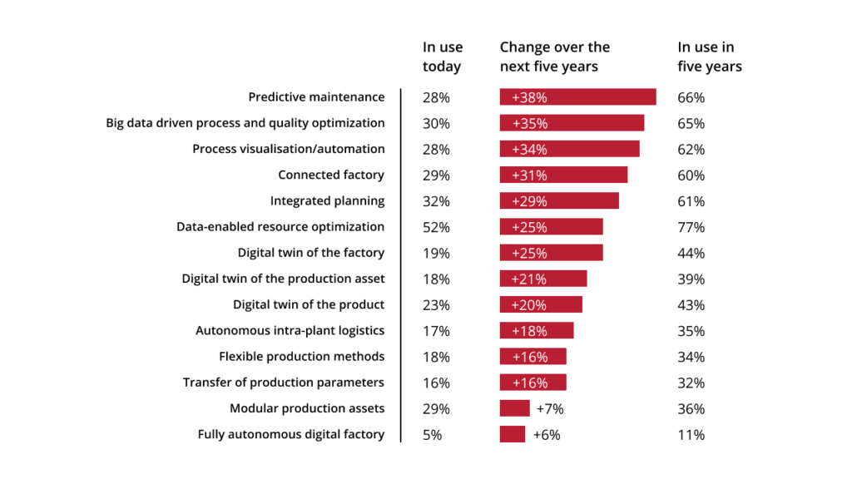
AI/ML in manufacturing:
https://www.pwc.de/de/digitale-transformation/digital-factories-2020-shaping-the-future-of-manufacturing.pdf

Slide 30



Why use ML?
Harvey
Business Professional
Ayo
Machine Learning
Knowledge, intuition and experience
Fresh, unbiased perspective
“A.I. may not replace managers, but the managers that use A.I. will replace the managers that do not.”
Rob Thomas
IBM CCO
Might overlook minute details occasionally
Consistently spots even the tiniest patterns
Understands client relationships & emotions
Offers objective, data-backed insights
Insights from personal interactions
Patterns from across the company and industry
Processes a limited set of data at a time
Analyzes very large datasets simultaneously

Slide 31
ML project example (simplified)
Business objective: Generate more revenues and expand market reach.
Data Preparation (30% of time):
Gather 5000 assignments from 500 clients on the market.
Clean and preprocess the data to ensure quality.
Insight Mining (25% of time):
Use Data analytics or Machine learning techniques.
Dive deep to find patterns, correlations, and trends in the data.
Model Testing & Deployment (20% of time):
Fine-tune the model based on initial findings.
Deploy the model to ensure it's ready for real-world data.
Real-world Application (25% of time):
Apply the model to ongoing data.
Outputs:
A. Tailored marketing recommendations for client segments.
B. New potential service bundles based on past client behavior.
C. Forecasting to predict which services will be in high demand.

Slide 32
AI/ML models in production
Many forms of user interface:
Web application (Chrome, IE etc)
Desktop software
Dashboards
Mobile applications
Embedded & IoT
In variety of cases these can be integrated in existing ERP systems.

Slide 33
AI integration to Business

Slide 34

AI: An Opportunity and a Risk
AI is viewed by business leaders as both an opportunity and a risk
From a 2019 BCG/MIT report:
9/10
45%
companies feel AI presents a business opportunity
of companies feel AI poses some business risk
“what if competitors, particularly new entrants, figure out AI before we do?”
Driven by the opportunities and risks, companies in many industries have announced AI initiatives
@stanford.online

Slide 35
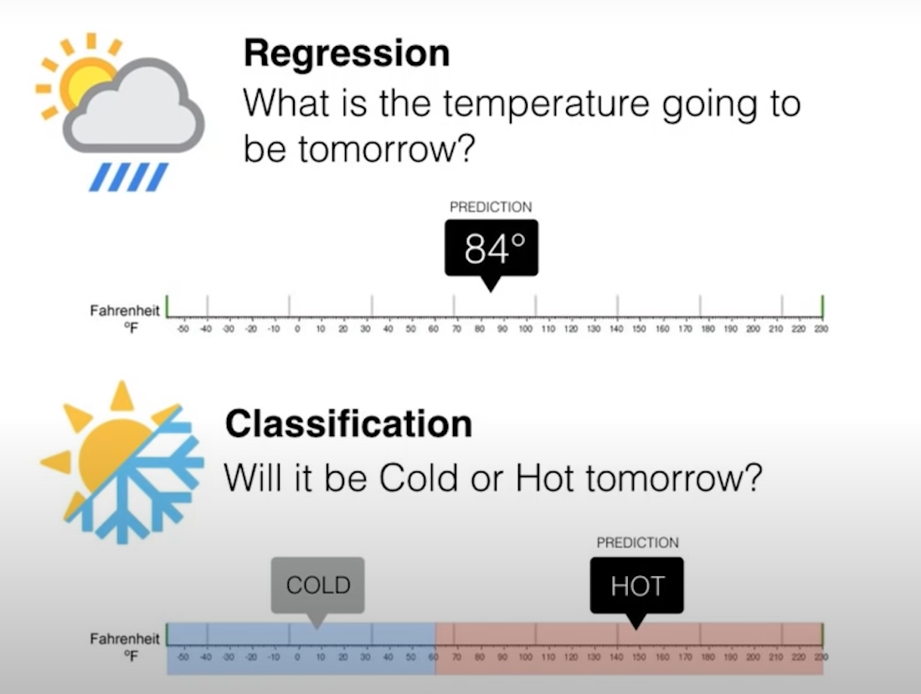
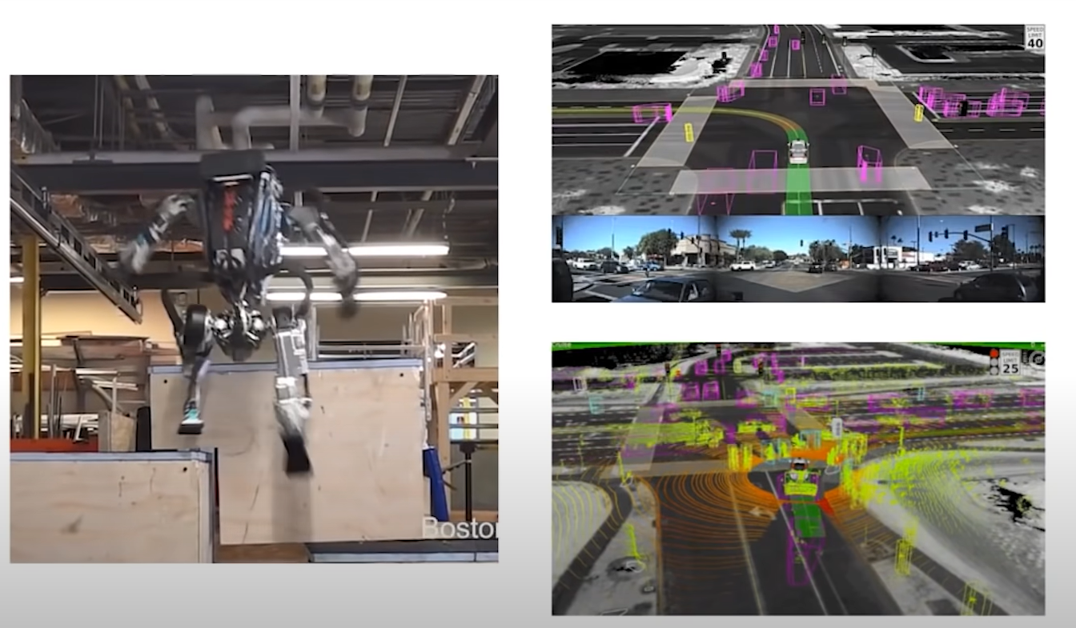
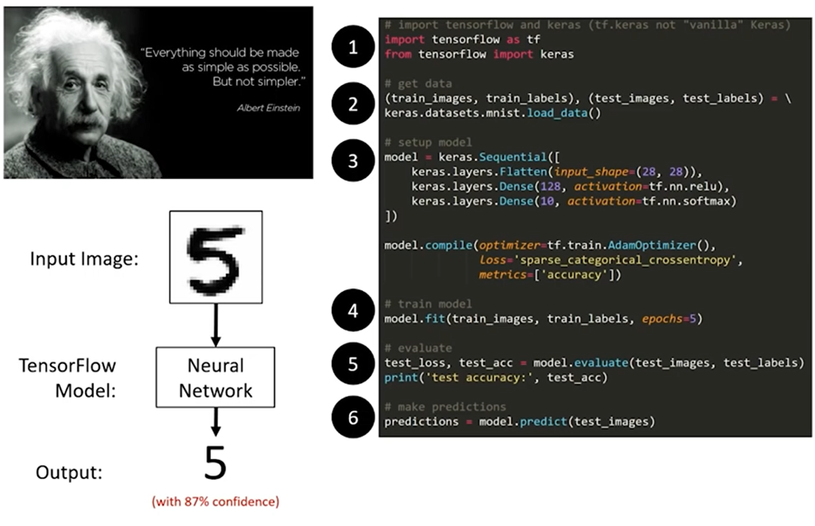
Approach AI implementation
Business first. Tech second
AI is not the destination
Start small. Think big.
Use portfolio approach
@deeplearning.ai

Slide 36
A Portfolio Approach to AI
A portfolio approach can help to successfully unleash the power of AI tools & solutions and incorporate them seamlessly into business.
redefine end-to-end processes
AI Portfolio = Quick Wins + Long Term Projects
optimization at a touch point
@deeplearning.ai

Slide 37
AI implementation ladder by IBM:
Step 1: Collect - Gather data from various sources, ensuring simplicity and accessibility.
Step 2: Organize - Create a trusted foundation with built-in governance, protection, and compliance.
Step 3: Analyze - Utilize AI models to gain insights and make informed decisions with transparency.
Step 4: Infuse - Operationalize AI across the business for predictions, automation, and optimization.

Slide 38
KK Technologies proposal:
STEP 1 and 2: assumed done or contact digital transformation agency
STEP 3 – First actions:
Data Deep Dive - Analyze operational, financial, and client interaction data to identify key trends and patterns.
Business Recommendations - suggest actionable strategies based on the insights from the patterns recognized.
RESULT:
Comprehensive Analytics Report with specific steps to leverage the insights for immediate revenue growth and client engagement.
AI Prototype Models demonstrating potential improvements in service prediction and operations optimization.

Slide 39
Key takeaways:
Data is a valuable asset.
AI is a powerful tool, not a destination.
Most industries is already embracing AI.
Kick off today to be ready for tomorrow.

Slide 40
Thank you for attention!
George Shevardenidze
Data analytics,
AI/ML for
B2B services,
Energy, Oil & Gas
shevardg@gmail.com
+995 555 22 32 46

Slide 41
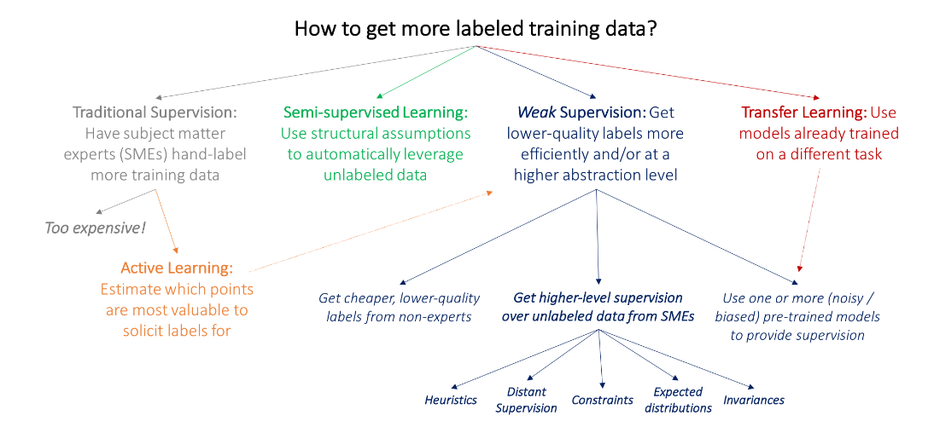
@deeplearning.ai

